Slide 1

GOZWHIT
A smart and secure helmet
Presented by :
Sailesh Patra-13BCE1119
Marla Akhil Reddy-13BCE1078
Chava Sai Teja-13BCE1032

Slide 2
PRESENT PROBLEMS
There has been a multiple-fold rise in number of road accidents in the recent days and many-a-times, the emergency services have faced the difficulty on timely response to the situation.
In large cities, sometimes the emergency services find it difficult to locate the spot of the accident as based on a phone call.

Slide 3
IDEA DESCRIPTION
This project is basically about an implementation of innovative mechanisms to a rider’s helmet to bring out the following advantages –
Internet of Things(IoT) based traffic emergency system
Internet of Things(IoT) based traffic guidance system
Extensive protection from sun strokes
Other useful common utilities
All these facilities are to be implemented on the helmet with maximum cost efficiency to make the final product within the reach of Indian common man.

Slide 4
IoT based Traffic Emergency System
Here the helmet will be mounted with appropriate sensors at appropriate positions on the helmet. They are calibrated to sense high impact due to any accident or crash.
Once they detect the designated input, the rider’s location is immediately sent to a cloud of hospitals where the nearest hospital is notified about that so that ambulance can reach the spot immediately.

Slide 5
What are the things in this project?
Rider’s Helmet
Ambulance
Hospital

Slide 6
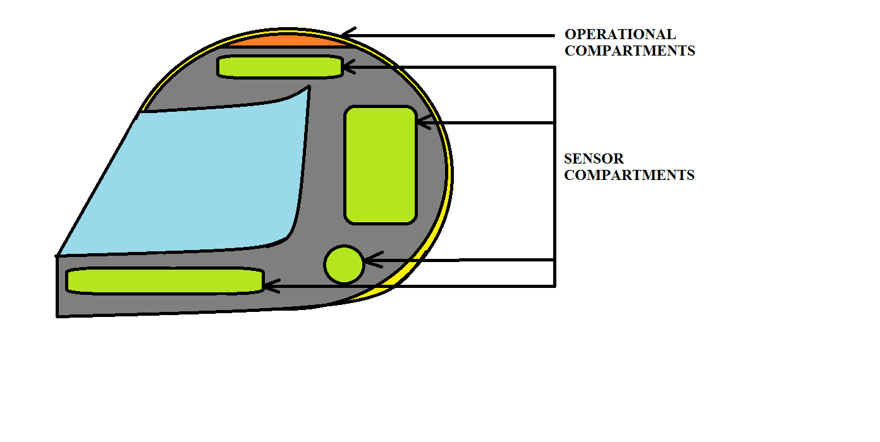
Cross Sectional Diagram

Slide 7
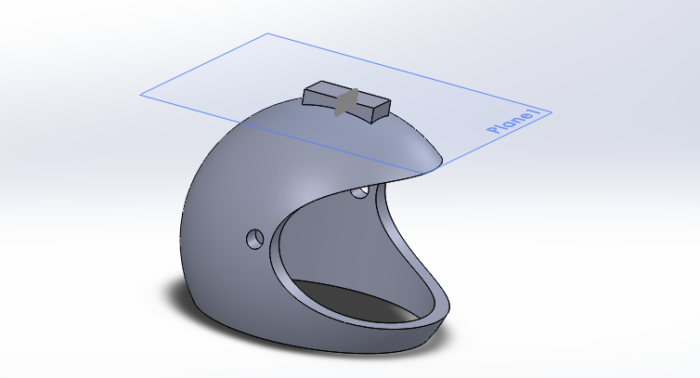

Slide 8
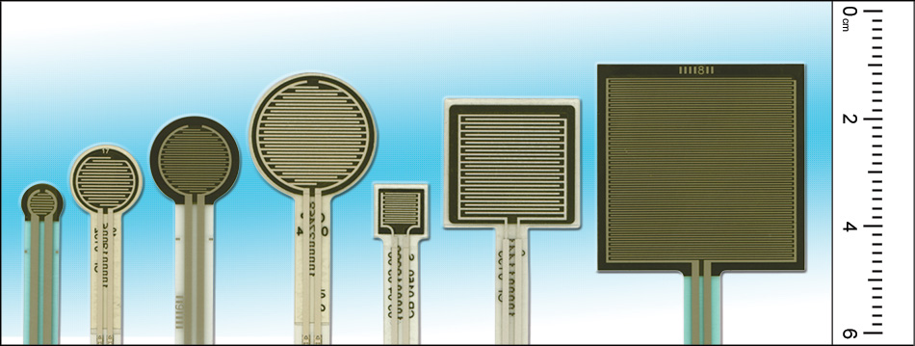
Force-sensing resistor

Slide 9
Force-sensing resistors consist of a conductive polymer, which changes resistance in a predictable manner following application of force to its surface.
The sensing film consists of both electrically conducting and non-conducting particles suspended in matrix. The particles are sub-micrometre sizes, and are formulated to reduce the temperature dependence, improve mechanical properties and increase surface durability. Applying a force to the surface of the sensing film causes particles to touch the conducting electrodes, changing the resistance of the film. As with all resistive based sensors, force-sensing resistors require a relatively simple interface and can operate satisfactorily in moderately hostile environments. Compared to other force sensors, the advantages of FSRs are their size (thickness typically less than 0.5 mm), low cost and good shock resistance.

Slide 10
IoT CLOUD
SEARCH FOR THE NEAREST HOSPITAL
TRIGGER
DETAILS
LOCATION
LOCATION
DETAILS
DETAILS
DETAILS
APP TRIGERED
AMBULANCE
HOSPITAL
BLUE-TOOTH
SENSORS ACTIVATED UPON ADEQUATE PARAMETERS

Slide 11
ADVANTAGES
Immediate response to any accident by the emergency services since all of them become a part of network(of things).
The location of the accident is too updated to the emergency services so that finding the location wont be such a trouble.
Details of the personnel is also updated to the emergency service centre so that formalities of paper-work may be completed in before hand.

Slide 12
FURTHER SCOPE IN THE PROJECT
This project can further be implemented for a varieties of traffic utilities to ensure the safety and convenience of the people.
This project can be used to implement a health-care system for the riders by constantly analysing the dehydration rate and reminding appropriately. The concept of IoT can be extended to the bike where the parameters are constantly analysed for servicing remainders.

Slide 13
THANK YOU

